Slide 1
Information Architecture

Slide 2
Information Architecture Basics
Information architecture (IA) is the art and science of organizing and labelling websites.
It focuses on organizing, structuring, and labeling content in an effective and sustainable way.
Goal:
The purpose of your IA is to help users understand where they are, what they’ve found, what’s around, and what to expect (Morville and Rosenfield, 2006), .
Organizing web site content so that it can be found, designing website interaction so that it's pleasant to use, and creating an interface that is easy to understand (Wodtke and Govella, 2009).

Slide 3
Main Components of Information Architecture
Organization Schemes and Structures: How you categorize and structure information
Labeling Systems: How you represent information
Navigation Systems: How users browse or move through information
Search Systems: How users look for information
Example: https://blogs.library.duke.edu/wp-content/uploads/2013/03/lib-ia-1.3.1-20130311.png
Note: In order to create these systems of information, you need to understand the interdependent nature of users, content, and context.

Slide 4
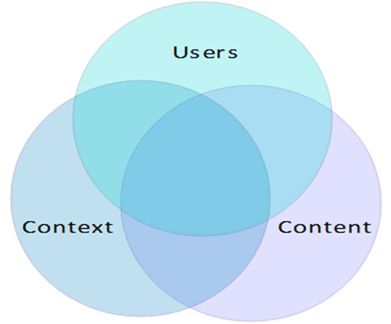
Main Components of Information Architecture
Context: business goals, funding, politics, culture, technology, resources, constraints
Content: content objectives, document and data types, volume, existing structure, governance and ownership
Users: audience, tasks, needs, information-seeking behavior, experience

Slide 5
Main Components of Information Architecture
Organization Schemes
Entail how you are going to categorize your content and the various ways you'll create relationships between various pieces.
Most content can be categorized in multiple ways.
Schemes can be broken down into:
Exact Schemes: objectively divide information into mutually exclusive sections Subjective Schemes: categorize information in a way that may be specific to or defined by the organization or field

Slide 6
Main Components of Information Architecture
Exact Schemes - Examples of exact organizational structures include:
Alphabetical schemes: make use of our 26-letter alphabet for organizing their contents. Sometimes, alphabetical schemes in the form of an A-Z index serve as secondary navigational components to supplement content’s findability that is otherwise organized.
Chronological schemes: organize content by date. For example, blog posts, news articles, etc.
Geographical schemes: organize content based on place.
Often these types of schemes serve as a good supplemental way to navigate a site that that is otherwise organized. For example, you may choose to provide a map to display information or an A-Z index to get to topics grouped primarily by one of the subjective schemes.

Slide 7
Main Components of Information Architecture
Subjective Schemes - Examples of subjective schemes include the following:
Topic schemes: organize content based on the specific subject matter.
Task schemes: organize content by considering the needs, actions, questions, or processes that users bring to that specific content.
Audience schemes: organize content for separate segments of users. Audience schemes can be closed or open, meaning that users are able to navigate from one audience to another.
Metaphor schemes: help users by relating content to familiar concepts. This is used in interface design (folders, trash, etc.) but can pose challenges when used as the site’s primary organization scheme.

Slide 8
Main Components of Information Architecture
Wireframing
A wireframe is a two-dimensional illustration of a page’s interface that specifically focuses on space allocation and prioritization of content, functionalities available, and intended behaviors.
Wireframes typically do not include any styling, color, or graphics.

Slide 9
Main Components of Information Architecture
The Value of Wireframes
Wireframes serve multiple purposes by helping to:
Connect the site’s information architecture to its visual design by showing paths between pages
Clarify consistent ways for displaying types of information on the user interface
Determine intended functionality in the interface
Prioritize content through the determination of how much space to allocate to a given item and where that item is located
Example: https://www.lucidchart.com/pages/templates/wireframe

Slide 10
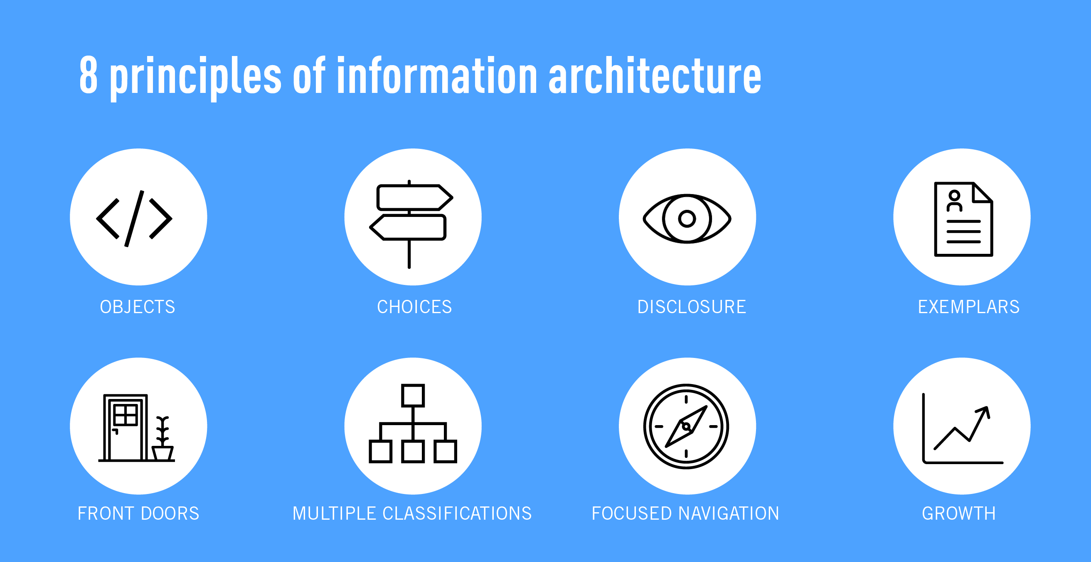
8 Principles of Information Architecture

Slide 11
8 Principles of Information Architecture
The principle of objects: Content should be treated as a living, breathing thing. It has lifecycles, behaviors, and attributes.
The principle of choices: Less is more. Keep the number of choices to a minimum.
The principle of disclosure: Show a preview of information that will help users understand what kind of information is hidden if they dig deeper.
The principle of exemplars: Show examples of content when describing the content of the categories.

Slide 12
8 Principles of Information Architecture
The principle of front doors: Assume that at least 50% of users will use a different entry point than the home page.
The principle of multiple classifications: Offer users several different classification schemes to browse the site’s content.
The principle of focused navigation: Keep navigation simple and never mix different things.
The principle of growth: Assume that the content on the website will grow. Make sure the website is scalable.

Slide 13
IA Implementation: Organizational Elements
Organizational elements don't have obvious physical manifestations
The purpose is to group web page content into sections so that you can use CSS and JavaScript to manipulate their content more effectively. Example: article, aside, nav, section, header, footer
They are semantic element
Partly based on research by Google after crawling billions of pages
By default, all organizational elements span the width of their surrounding containers, i.e., block elements
The first four organizational elements are in the sectioning category from the content model categories diagram at https://www.w3.org/TR/html51/dom.html#kinds-of-content.

Slide 14
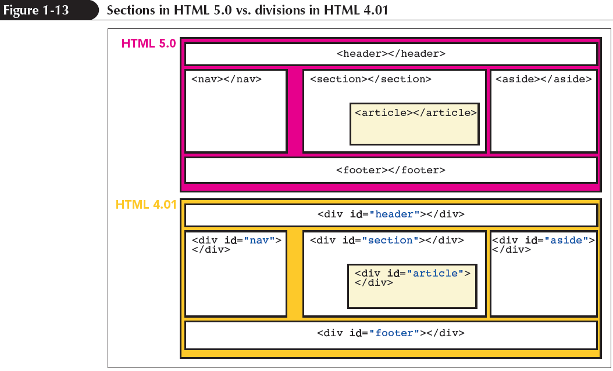
Organization in HTML4 and HTML5

Slide 15
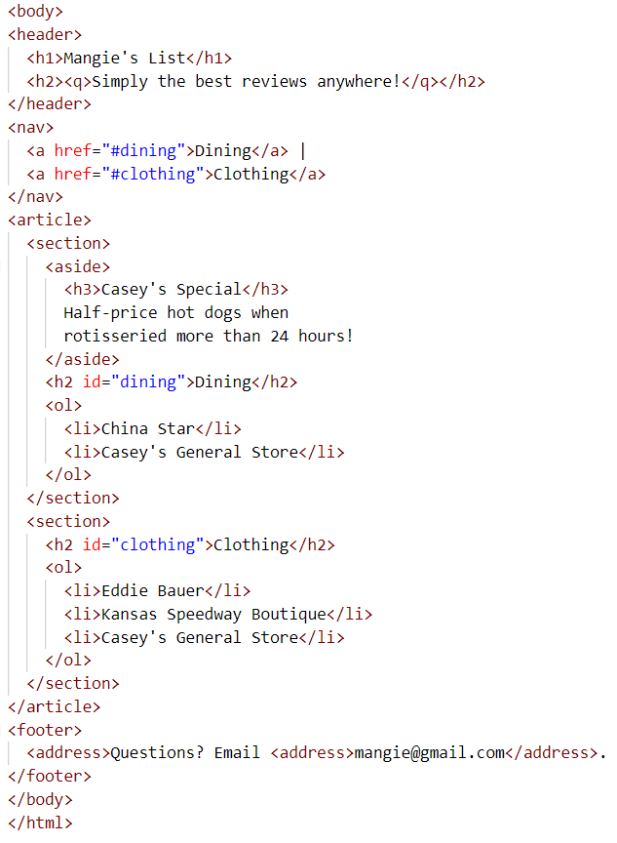

HTLM5 Organizational Elements
Note: The organizational elements have been styled to be displayed as shown in the figure

Slide 16
HTML5 Elements: header and footer
header element: group together header content.
footer element: group together content at the bottom of a web page.
address element: To provide contact information.
The contact information must be relevant to the portion of the web page where the address element resides.
does not group together other elements, so it's not an organizational element
it's common to include an address within a footer

Slide 17
HTML5 Elements: nav and a
A nav element group together navigational links
A hyperlink (simply known as link) is created using <a>
<a href="#resto">Dining</a>
The Dining text is the content of the <a> element. Without content, the link will not work
On the previous code, note the id value of “resto" of h2:
<h2 id="resto">Restaurant</h2>
When a user clicks on the above a element link, the browser jumps down to the h2 resto element.

Slide 18
HTML5 Elements: article, section, and aside
article element:
Commonly used to group together one or more sections.
It can be independently distributable or reusable, e.g., in syndication
The HTML5 standard describes an article as forming an independent part of a web page or website.
section element:
Used to group together a section of a web page.
Typically contain a heading and one or more paragraphs.
aside element:
Used to group together content that has something to do with the rest of the web page, but it isn't part of the main flow.
Typically, you should position an aside element at the right or left, usually with the CSS properties float and width.

